Slide 1

GROUP NO 16
UAVs
UNMANNED AERIAL VEHICLES
PROF: Dr. Yash Vasavada

Slide 2
Honor code
We, the members of group 16, declare that,
the work that we are presenting is our own work.
We have not copied the work that someone else has done.
Concepts, understanding and insights we will be describing, are our own.
Wherever we have relied on an existing work that is not our own, we have provided a proper reference citation.
We make this pledge truthfully. We know that violation of this solemn pledge can carry grave consequences.

Slide 3
Table of Contents
Introduction
UAVs in 6G network
Introduction to UAVs
Their classification and usages. The application of UAVs are discussed.
In this section, we have covered how the 6G network will bring technological revolution in communication. We also discussed the use of UAVs in that revolution.
Challenges regarding UAVs
U2U Communication
We see some problems that occur when we deploy UAVs Practically as flying wireless platform.
UAV to UAV communication is very useful in terms of energy efficiency, power control. U2U communication can be used to improve the overall network throughput.
UAV in 5G NR network
UAVs can be used in 5G NR network as they can provide high data rate and also have mobility. UAVs can be used in massive MIMO and also mmWave communication.
Simulation of UAVs
Simulation of UAV communication using aerial relay UAVs.

Slide 4
Introduction
UAVs popularly known as drones can be used in wireless communication because of their characteristics such as mobility, flexibility, adaptive altitude, etc.

Slide 5
Classification
LAP
Altitude
UAV
Classification
HAP
Type
Rotary-wing
Fixed-wing

Slide 6
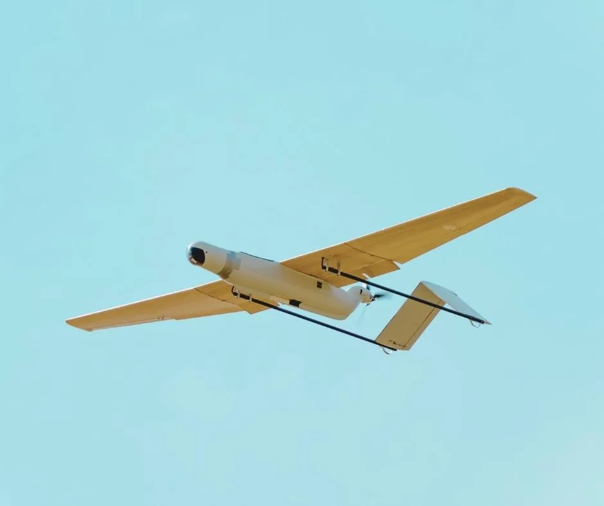
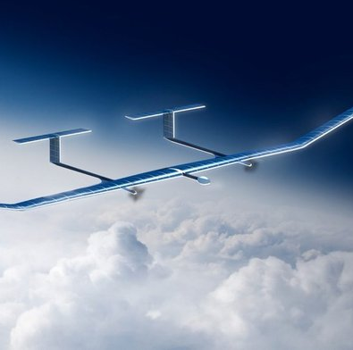
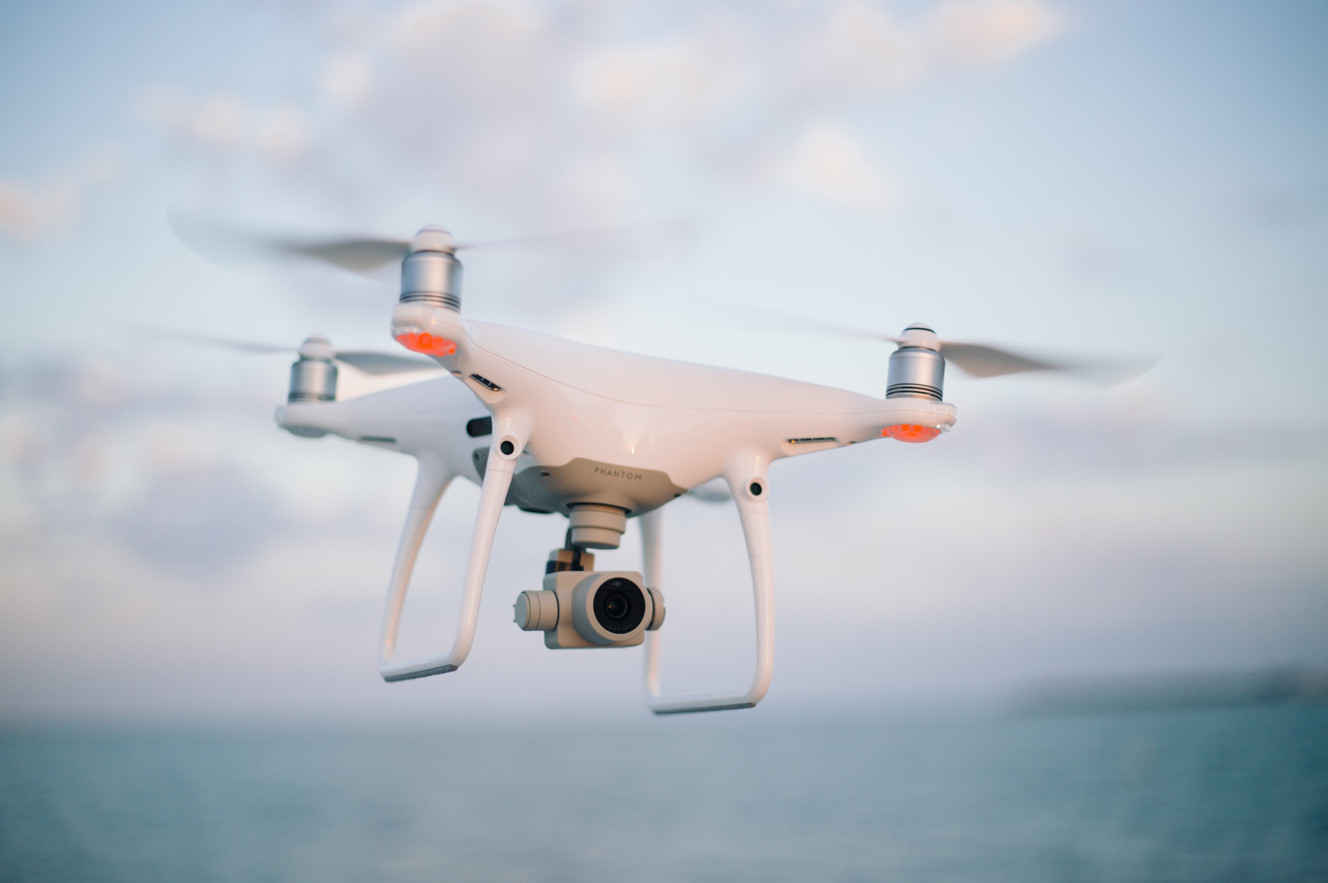
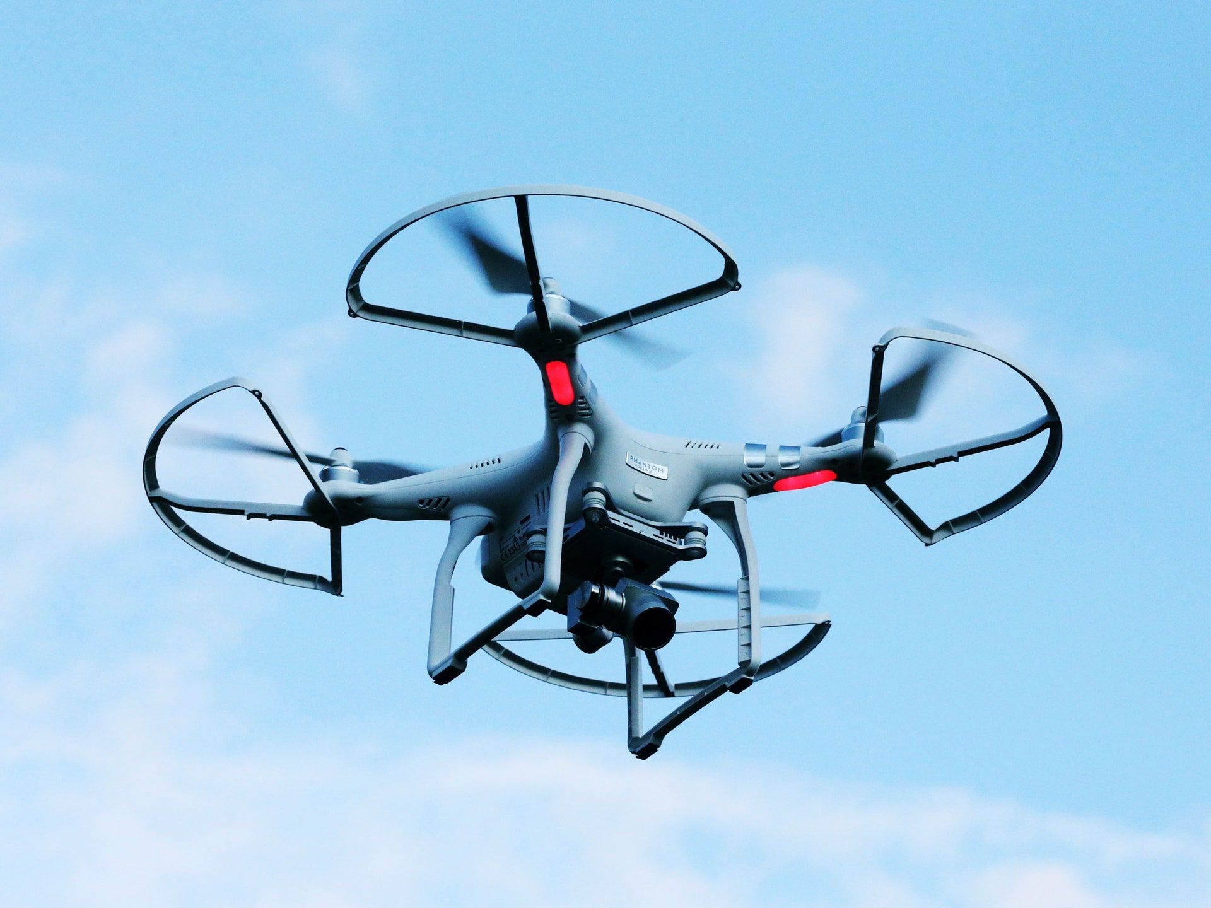
Classification
[6]
[3]
[4]
[5]

Slide 7
Application
UAVs as Flying Base Stations for Public Safety Scenarios
Cellular-Connected Drones as User Equipements
UAV-Assisted Terrestrial Networks for Information Dissemination
Flying Ad-Hoc Networks With UAVs
Aerial Base Station
Other
3D MIMO and beamforming Communications
UAVs as Flying Backhaul for Terrestrial Networks
Coverage and Capacity Enhancement of Wireless Cellular Networks
Smart Cities

Slide 8
Challenges in UAV communication
Challenge 1
Challenge 2
Optimal Deployment of UAV
Channel Modeling
Performance Analysis of UAV-Enabled Wireless Networks
Resource Management & Energy Efficiency
Challenge 3
Challenge 4

Slide 9
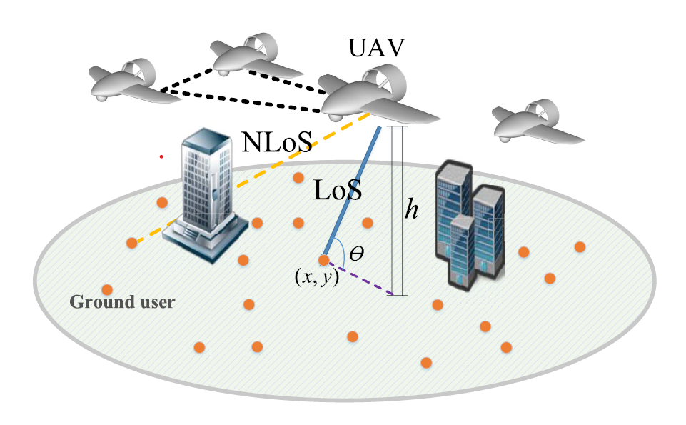

Air-to-Ground Channel Modeling
The modeling of A2G channel is important for optimal design and deployment of UAV-based communication systems.
The A2G channel is highly dependent on altitude, type of UAV, elevation angle, and propagation environment
This equation shows the probability of having LoS connection between aerial base station and ground users is an increasing function of elevation angle.
$P_{LoS}=\frac{1}{1+C e^{−B\left(Θ−C\right)}}$
[2]
[2]

Slide 10
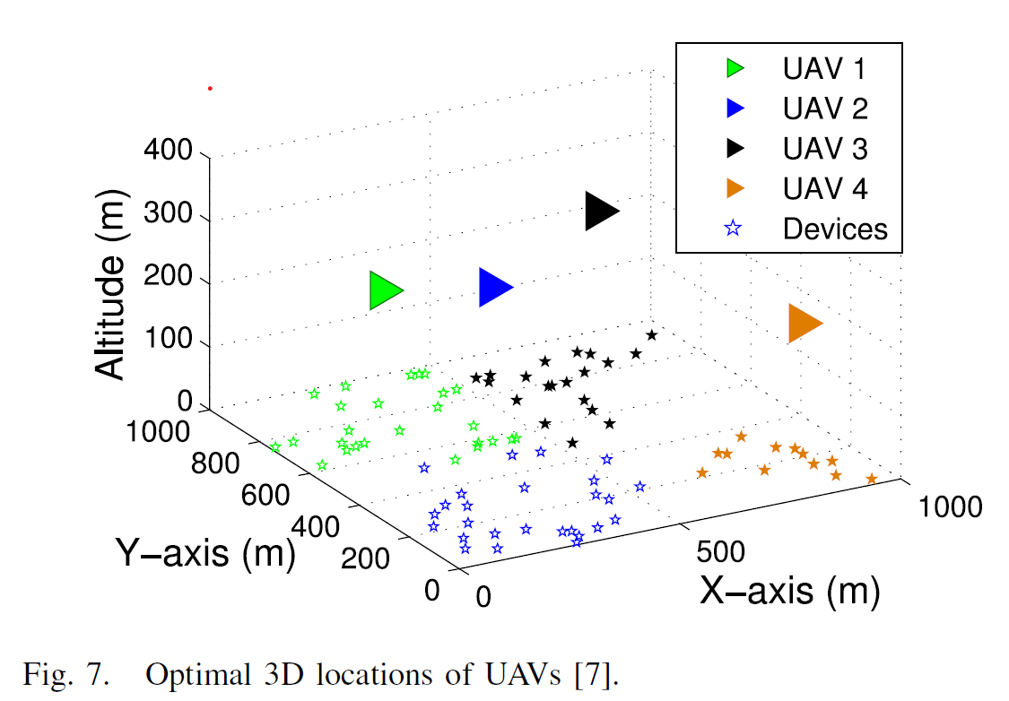
Optimal deployment of UAVs as aerial BS
The three dimensional deployment of UAVs is one of the key challenges in UAV based communication. But the adjustable height and their mobility provide a better opportunity for an efficient deployment.
It depends on various factors such as deployment environment, location of ground users, and UAV-to-ground channel characteristics, which are impacted by the UAV's altitude.
Multiple UAV deployment also poses a challenge due to inter-cell interference. Unlike terrestrial base stations, UAV deployment requires consideration of flight time and energy constraints.
[2]

Slide 11
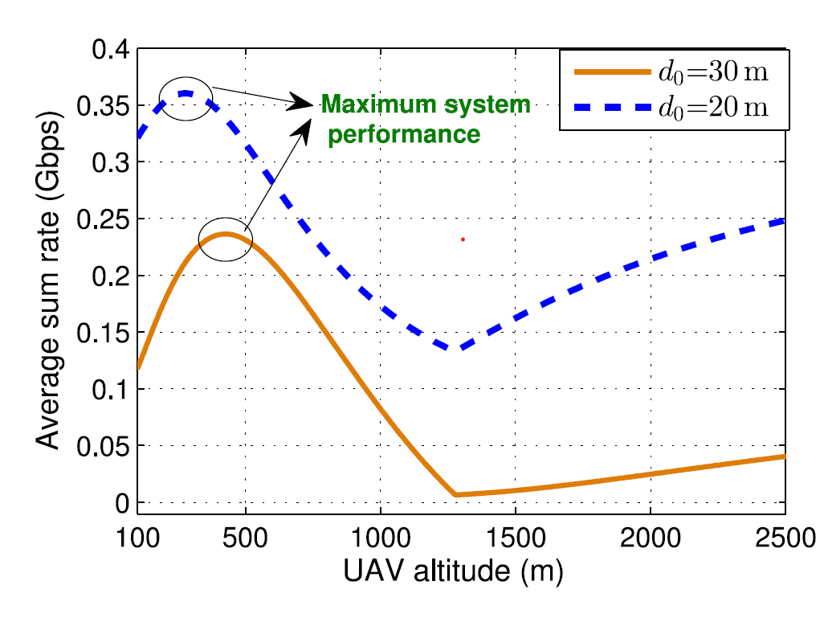
Performance Analysis of UAV-Enabled Wireless Networks
A fundamental analysis of the performance of UAV-enabled wireless systems is required in order to evaluate the impact of each design parameter on the overall system performance.
This is a analysis of a circular network in which a number of users which are spatially distributed, and a UAV – mounted aerial base station is used to serve a subset of those users. (UAV-D2D Network)
[2]

Slide 12

Resource Management and Energy Efficiency
The deployment and operation of UAVs in various applications require careful consideration of resource management and energy efficiency. UAVs face unique challenges due to their limited on-board energy, flight time, path planning.
In general, the total energy consumption of a UAV is composed of two main components,
1. Communication related energy
2. Propulsion energy
Energy consumption for fixed wing UAV,
$E=T (a_{1}V^{3}+ \frac{a_{2}}{V}$)
Energy consumption for a rotary wing UAV,
$$E=T\left[c_{1}\left(1+\frac{3V^{2}}{q^{2}}\right)+ {c_{2}\left(\sqrt{1+ \frac{V^{4}}{4v_{o}^{4}} } − \frac{V^{2}}{2v_{o}^{2}}\right)}^{\frac{1}{2}}+ \frac{1}{2}d_{0}ρsAV^{3}\right]$$
[2]
[2]

Slide 13
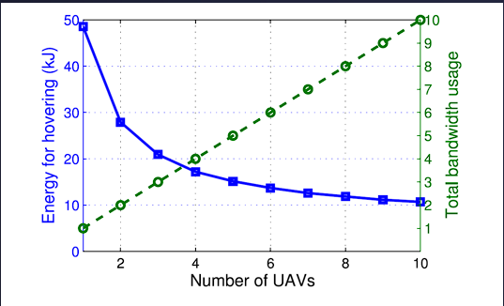
[2]
Resource Management and Energy Efficiency
In this simulation, the relation between hovering energy and number of UAVs is measured.
This simulation is done under the zero interference case. So, the total bandwidth linearly increases as the number of UAVs is increased.
Meanwhile, the total energy decreases as the number of UAVs increase.

Slide 14
UAV CELLULAR COMMUNICATIONS IN 5G NR
The increasing use of UAVs in various public and industrial applications will lead to,
Massive amount of data generation and hyper-high bit rates may become necessary in some applications.
Requirement of nearly unlimited flight range and strong wireless cellular empowerment to exchange the captured data with ground BSs.
The most demanding use cases of UAVs can be broadly classified into two categories,
1. Command and control
2. Payload data link

Slide 15
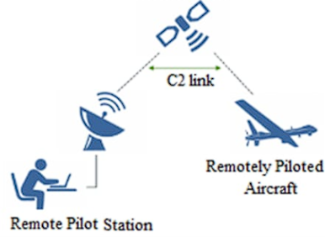
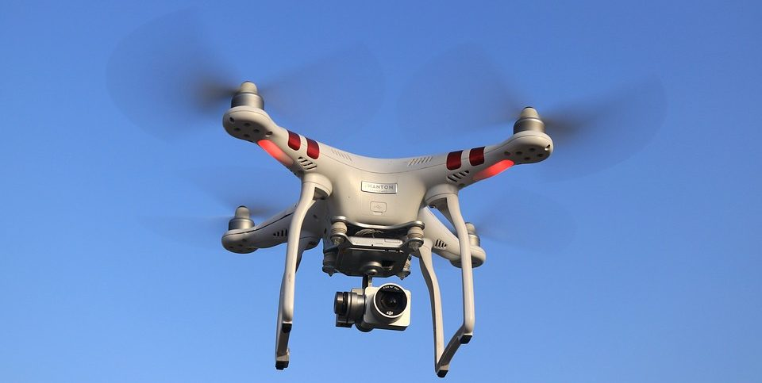
[7]
[8]
Command & control links
Payload data links
Includes data, such as altitude, speed, and GPS location
Commands and instructions from the operator to the UAV
Commercial doorstep delivery : A controller will be employed where controller and UAVs both are 5G-complaint devices; direct steering control requires UL video feedback from the UAV
It is a type of communication link that allows to control the payload of the UAV.
UAVs are expected to enable users to experience VR.
For example, through a 360-degree spherical view camera on board, the UAV captures and uploads 8k in real time to a cloud server, requiring a high bit rate and low latency

Slide 16
NR features in support of UAV
LTE / NR Dual Connectivity :
Coexisting of LTE and NR in the same geographical area have several benefits.
More reliable communication
More power efficient
Massive MIMO and mmWave :
Serving multiple user on each time-frequency
Opportunity to meet the demands of more high-data-rate hungry applications

Slide 17
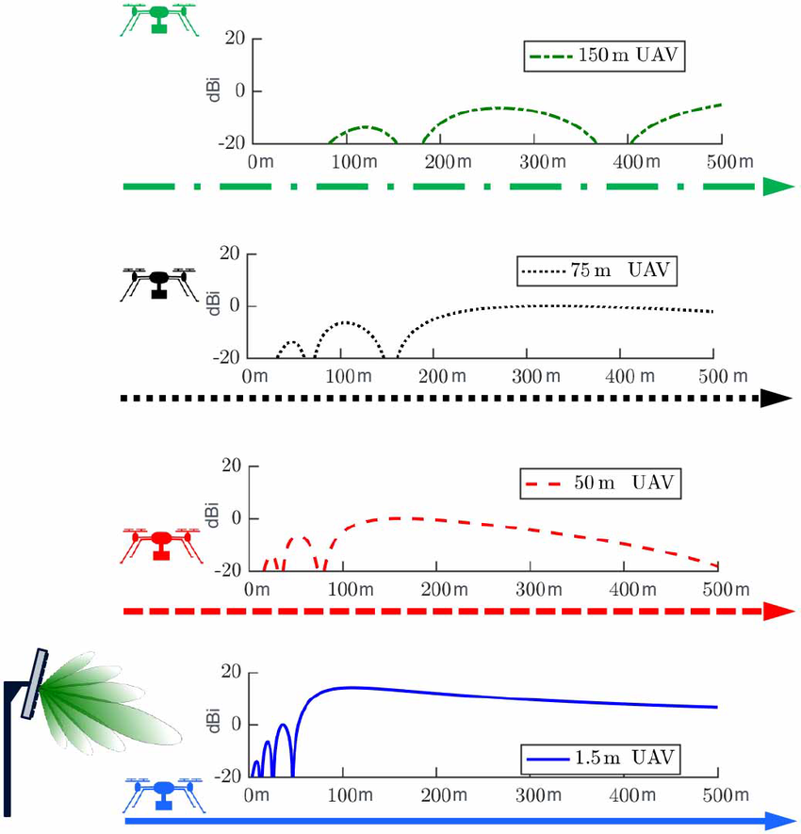
UAV Cellular communication
Transmission of payload data and for other application, cellular connected UAVs must access the network. For this purpose BSs regularly transmit synchronization signal-blocks.
Typically in cellular networks, BSs are down- tilted. This means that devices flying higher than BSs could only perceive SSB signals through antenna sidelobes.
Antenna gain vs BS-to-UAV distance for a BS deployed at 25 m and UAVs of various heights
[1]

Slide 18
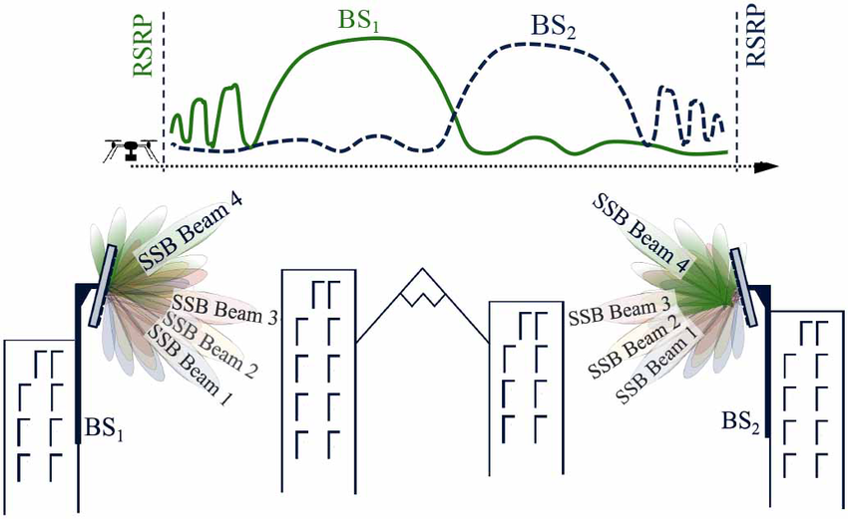
The problem mentioned above can be solved through NR BSs, because it can be transmitted towards multiple directions through time-multiplexed beam sweeping.
The SSBs introduced in NR can make initial cell selection and subsequent handovers for UAV much easier.
[1]

Slide 19
5G NR mMIMO for interference Management
The NR massive MIMO capabilities are critical to achieve the goal of creating a pervasive and sufficient signal quality.
This figure generates the output according to these 4 channels,
Single User - antenna array UAV
massive MIMO
massive MIMO – antenna array UAV
massive MIMO nulls
[1]

Slide 20
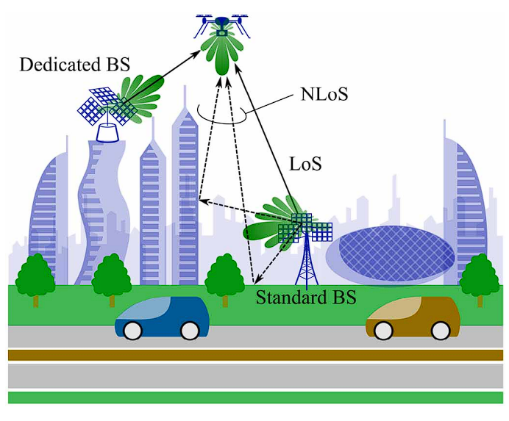
UAV urban coverage based on 5G NR mmWave
[1]
The urban mmWave network consists of down tilted standard BSs
Aerial coverage depends upon the angular and power distributions of signal paths and antenna patterns of UAV and BS.
To improve the mmWave communication system, we can introduce the dedicated BS for UAVs.
Dedicated BSs are uptilted BSs which are placed at the rooftops.

Slide 21
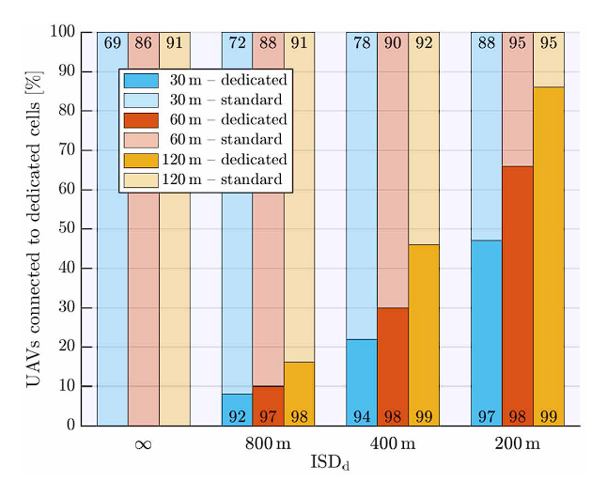
[1]
In this simulation, the LoS links for dedicated cells are written at the bottom of the cell while for the standard cell, it is at the top of the cell.
The simulation suggests that, at typical urban density, NR mmWave can provide satisfactory coverage to aerial links in spite of down tilted antennas.

Slide 22
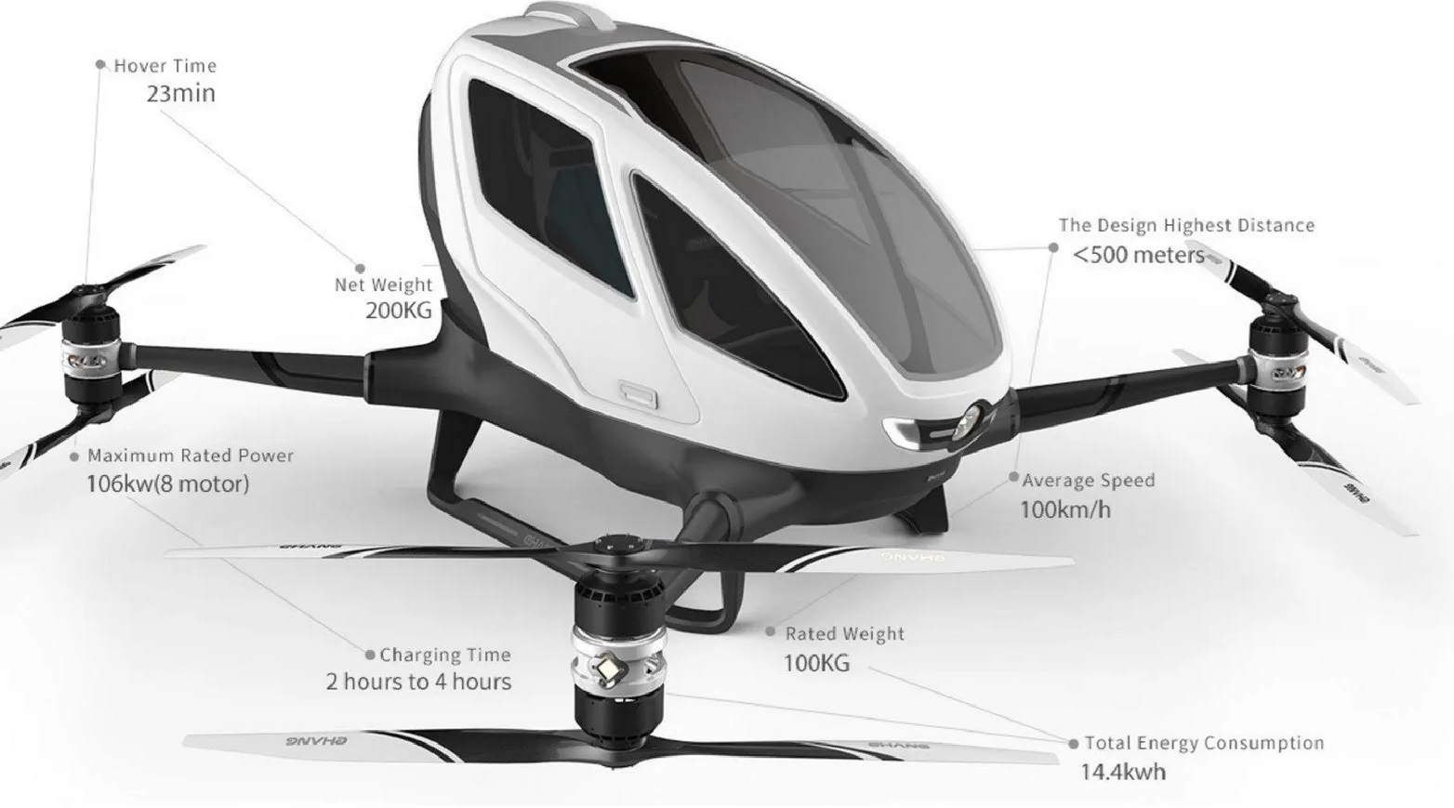
UAV in 6G communication
The future will bring more and more flying UAVs in the world.
In order to run it efficiently, we need reliable, seamless, robust network. 6G communication will be key point in that.
Compared to 5G, 6G will need to simultaneously provide ultra-reliable C2 and high speed aerial passenger connectivity to a much larger number of UAVs.
[9]

Slide 23
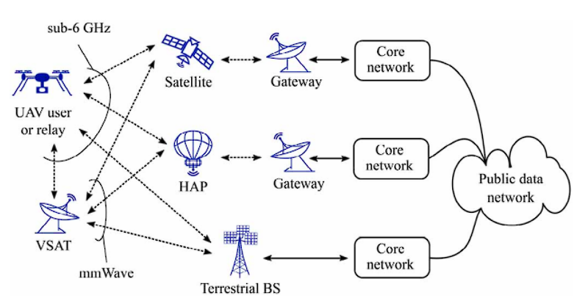
Integrated TN-NTN network
[1]
This is a potential architecture for an integrated ground-air-space network. Depending on the carrier frequency, it can directly serve a UAV or be relayed through a very small aperture Terminal(VSAT).

Slide 24
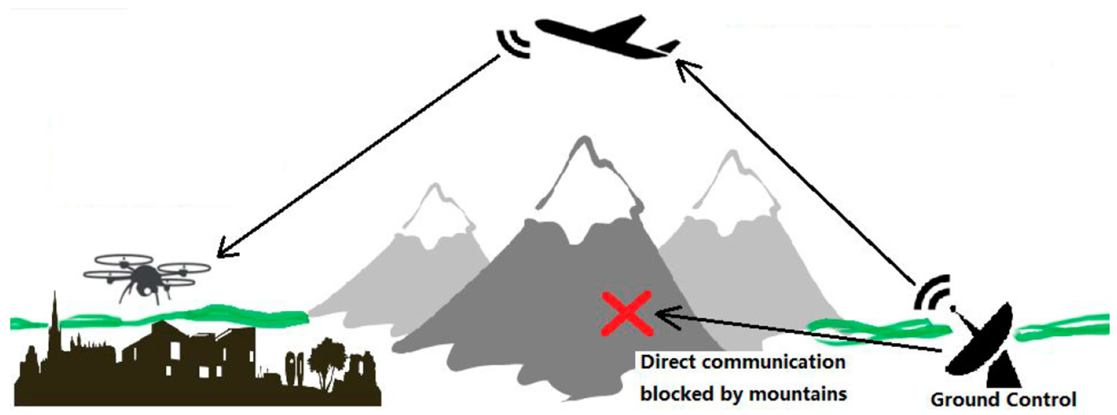
U2U Communication
U2U communication is the ability to communicate directly with each other without relying any ground BS.
U2U communication can provide several benefits such as,
1. Autonomous flight and collision avoidance
2. Co-operation in UAV swarms
3. Aerial relaying
[10]

Slide 25
Application of U2U communication
Autonomous flight and Collision avoidance:
Using autonomous operation on UAV devices, we can guarantee collision avoidance, So that the UAVs can do self control of aerial traffic.
2. Cooperation in UAV swarms:
Single UAV has limited processing capacity, payload capacity and range of communication. To meet specific goals, a group of UAVs may work together as swarms.
3. Aerial relaying:
Use of U2U communication enables aerial relaying to extend the coverage of ground BSs and serve users in remote or disaster areas.

Slide 26
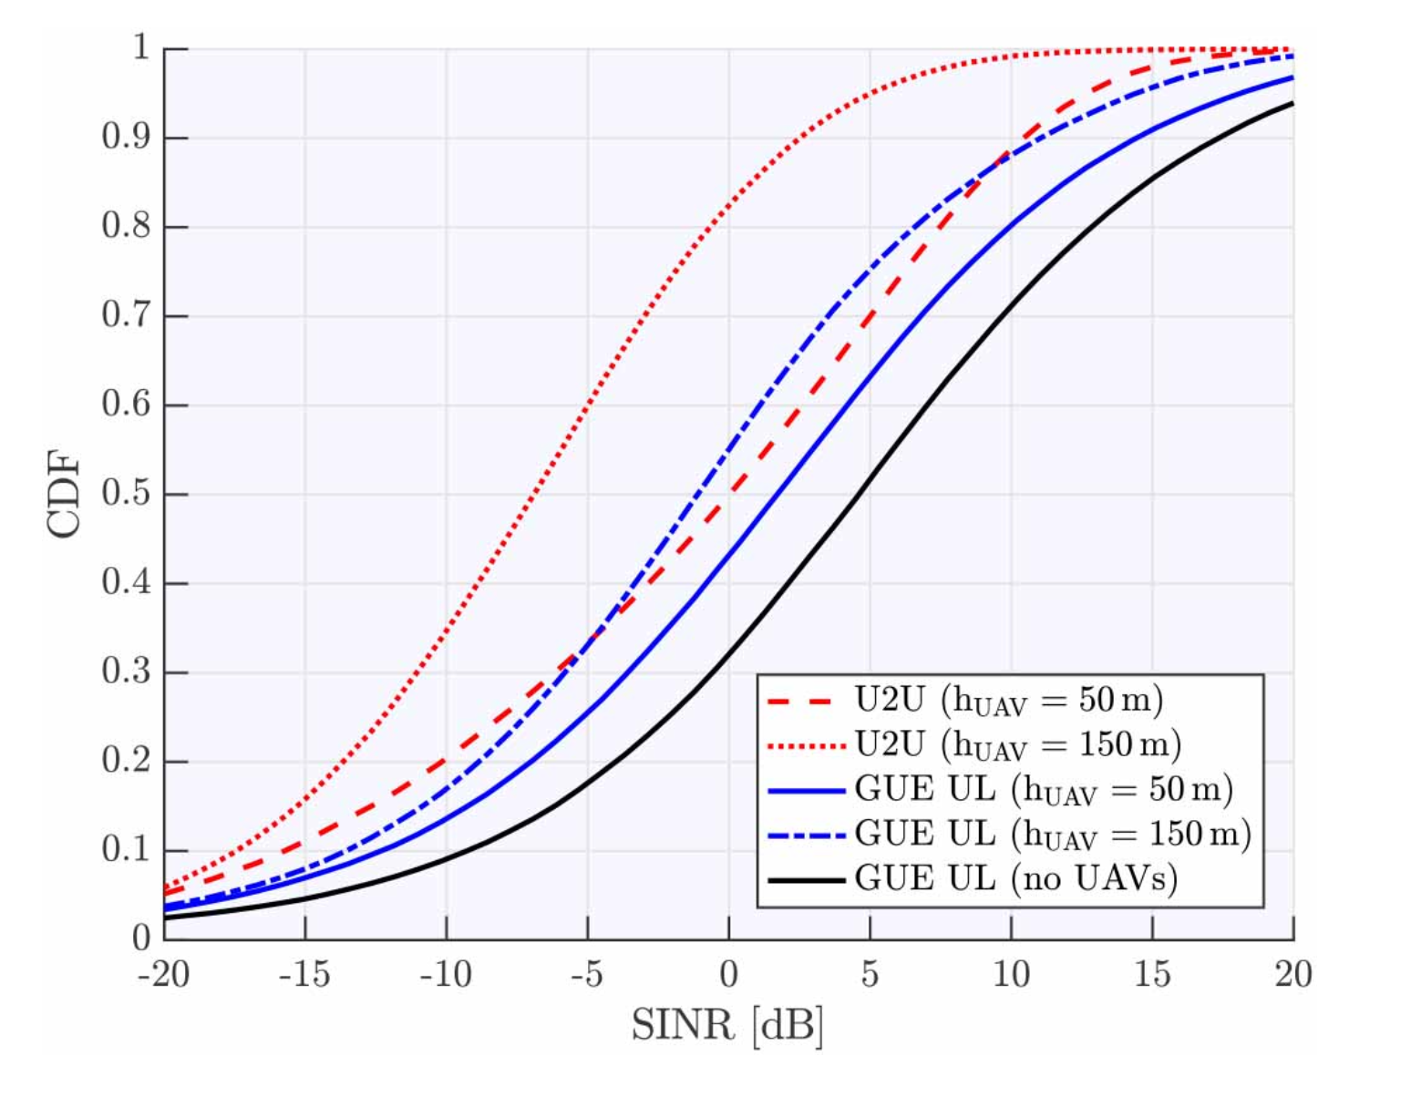
Impact of U2U communication on GUE
In this simulation, the distribution of GUE SINR and U2U SINR is plotted.
The graph shows that the UL performance of GUEs degrade in the presence of U2U link due to interference generated by aerial devices
Also, as the altitude of UAV increases, the SINR decreases.
[1]

Slide 27
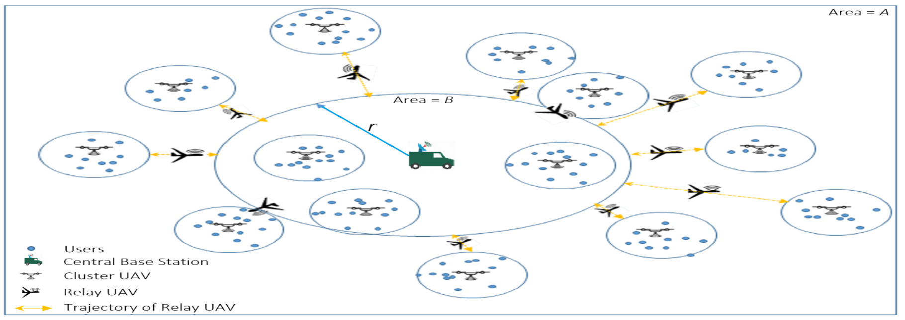
Simulation of UAV communication using relay UAVs
[11]
We have used the scenario of network deployment with cluster UAV, relay UAV and central BS.
Here, we have assigned cluster UAVs to each cluster of population.
As we can see, we used the relay UAVs for the cluster UAVs, which are outside the range of the central BS.

Slide 28
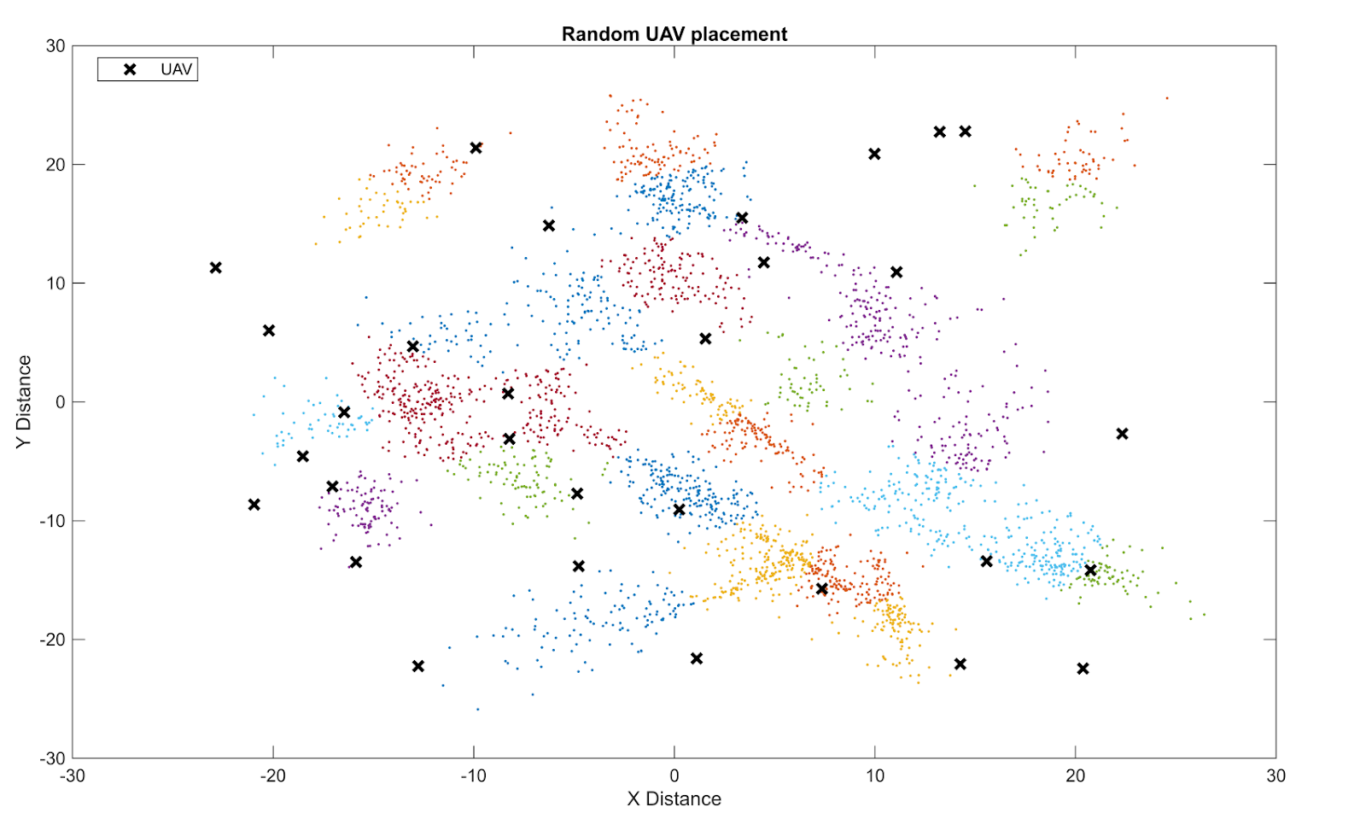
In our simulation, we have created users using the multivariate gaussian distribution. We placed the ground BS at the mean of the centroids.
The random placement of the cluster UAVs is shown here.

Slide 29
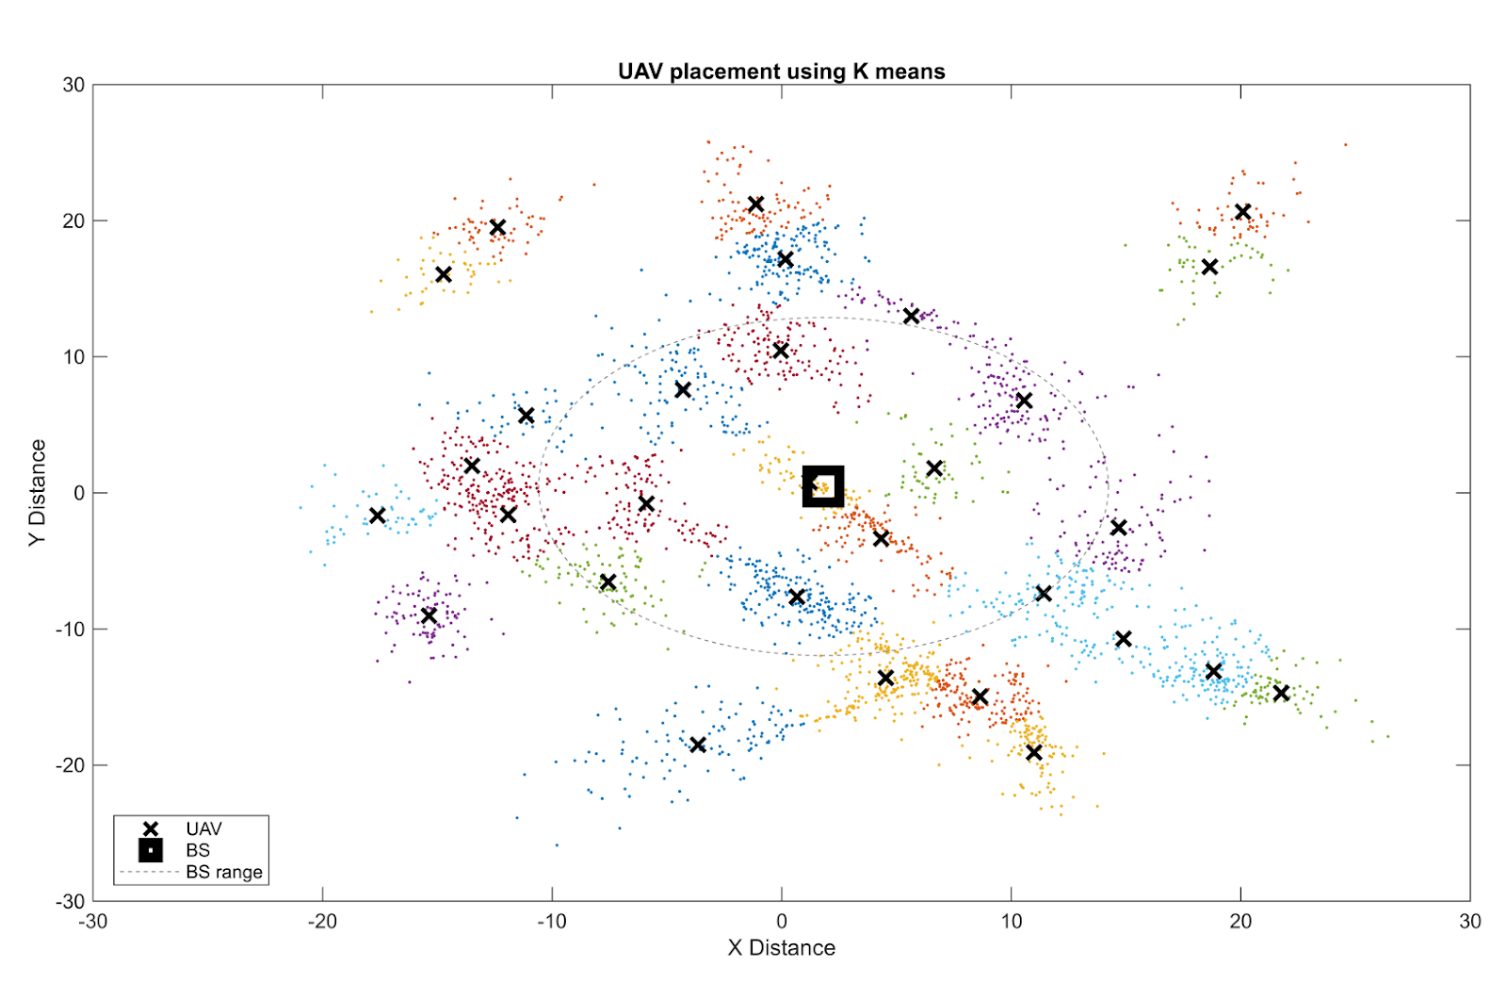
Then, using the K-means algorithm, we assigned a cluster UAV for each of the clusters.

Slide 30


We have used these equations to determine the optimal height, power.
$$\min_{P_{UAV}, H}{ βP_{UAV}+\left(1 − β\right)H}$$
$$0≤ P_{UAV}≤ P_{Threshold}$$
$$H≥ H_{Threshold}$$
$$W_{UAV} ∗log⁡(1+ \frac{P_{UAV}}{{\left(d_{{User}_{j}}\right)}^{α} N})≥ C_{Threshold}$$
[11]
We have used these equations to determine the optimal position of the relay UAVs.
By using these equations we can get one or two optimal positions for the relay UAVs.
$$C_{R_{i}}^{BS}=W_{CBS} ∗log⁡(1+ \frac{P_{UAV}}{{\left({d^{BS}}_{R_{i}}\right)}^{α}N})≥ C_{T}$$
$$C_{C_{i}}^{R_{i}}=W_{UAV} ∗log⁡(1+ \frac{P_{UAV}}{{\left(d_{C_{i}}^{R_{i}}\right)}^{α}N})≥ C_{T}$$
[11]

Slide 31
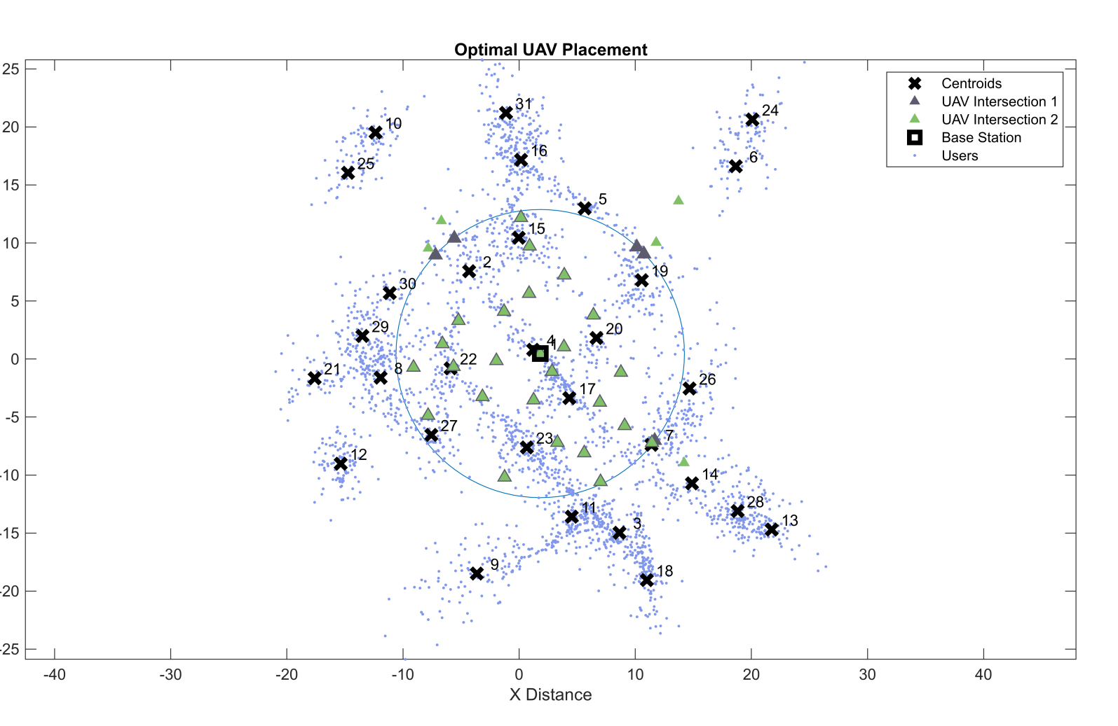
After applying equations, we can get the location of relay UAVs like this.

Slide 32
Conclusion
Hence, we conclude that for upgrading our conventional networks, UAVs can be really helpful. But there are still many challenges that are still need to be addressed.

Slide 33
Simulation code, the appendix and the notes of the project
Simulation code: https://github.com/KrishRupapara/Group16_UAVs/blob/main/group16_uav.m
Appendix : https://github.com/KrishRupapara/Group16_UAVs/blob/main/Appendix_Group%2016.pdf
Notes: https://github.com/KrishRupapara/Group16_UAVs/blob/main/Notes_Group%2016.pdf

Slide 34
Thank You
FOR YOUR TIME

Slide 35
GROUP MEMBERS
202101190: Dhyey Vachhani
202101192: Dhiraj Patel
202101193: Utpal Busa
202101194: Keni Patel
202101195: Utsav Maru
202101196: Viraj Rathwa
202101197: Kirtan Soni
202101198: Krish Rupapara
202101200: Jahnvi Verma
202101201: Bhargav Vidja

Slide 36
References
[1] Geraci, G., Garcia-Rodriguez, A., Azari, M. M., Lozano, A., Mezzavilla, M., Chatzinotas, S., ... & Di Renzo, M. (2022). What will the future of UAV cellular communications be? A flight from 5G to 6G. IEEE communications surveys & tutorials, 24(3), 1304-1335.
[2] Mozaffari, M., Saad, W., Bennis, M., Nam, Y. H., & Debbah, M. (2019). A tutorial on UAVs for wireless networks: Applications, challenges, and open problems. IEEE communications surveys & tutorials, 21(3), 2334-2360.
[3] HAPS – High Altitude Pseudo-Satellites – sciencesprings. (n.d.). Sciencesprings. https://sciencesprings.wordpress.com/tag/haps-high-altitude pseudo-satellites/
[4] Wikipedia contributors. (2023). Quadcopter. Wikipedia. https://en.wikipedia.org/wiki/Quadcopter#/media/File:Quadcopter_camera_drone_in_flight.jpg
[5] Allain, R. (2017, May 19). The Physics of How Drones Fly. WIRED. https://www.wired.com/2017/05/the-physics-of-drones/
[6] Dodson, M. (2022). Beginners Guide to Fixed-Wing Drones. Droneblog. https://www.droneblog.com/fixed-wing-drones/
[7] What are C2 Links? - everything RF. (n.d.). https://www.everythingrf.com/community/what-are-c2-links
[8] Drone Federation of India. (n.d.). Heathrow Archives - Drone Federation of India. http://dronefederation.in/tag/heathrow/
[9] Rundle, M. (2016, January 6). Ehang 184: a personal drone car that will probably never exist. WIRED UK. https://www.wired.co.uk/article/ehang-184-personal-drone-car
[10] Li, B., Jiang, Y., Sun, J., Cai, L., & Wen, C. Y. (2016). Development and testing of a two-UAV communication relay system. Sensors, 16(10), 1696.
[11] Prasad, N. L., Ekbote, C. A., & Ramkumar, B. (2021, July). Optimal deployment strategy for relay based UAV assisted cooperative communication for emergency applications. In 2021 National Conference on Communications (NCC) (pp. 1-6). IEEE.

